Slide 1



How to use education portal
Budapest University of Technology and Economics
Department of Sanitary and Environmental Engineering
Peter Budai
Budapest University of Technology and Economics Department of Sanitary and Environmental Engineering
budai.peter@epito.bme.hu

Slide 2
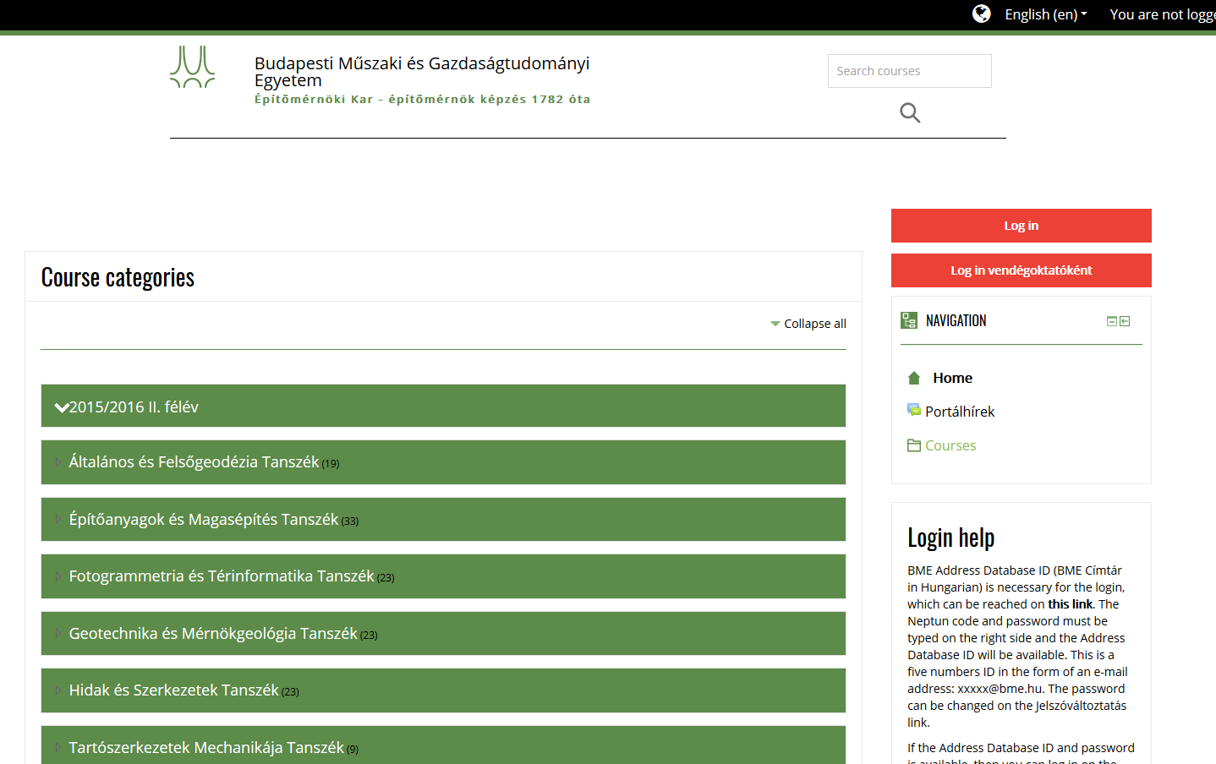
Budapest University of Technology and Economics
Department of Sanitary and Environmental Engineering
Course management and learning materials
http://edu.epito.bme.hu/

Slide 3
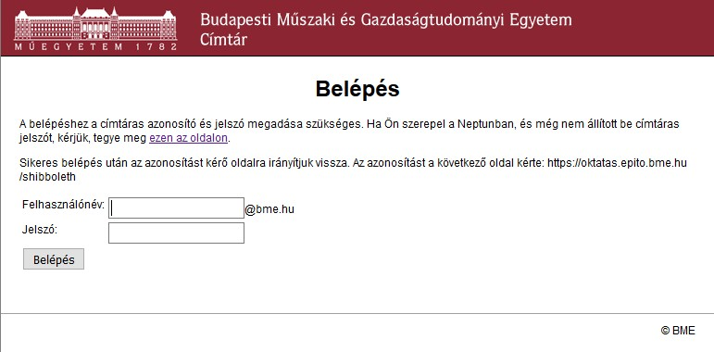
Budapest University of Technology and Economics
Department of Sanitary and Environmental Engineering
Course management and learning materials
BME Address Book – Login page
User ID: five-digit number
Password: your password

Slide 4
Budapest University of Technology and Economics
Department of Sanitary and Environmental Engineering
Course management and learning materials
If you do not have BME Address Book ID yet, you can set up one by clicking on the link that says: "ezen az oldalon"

Slide 5
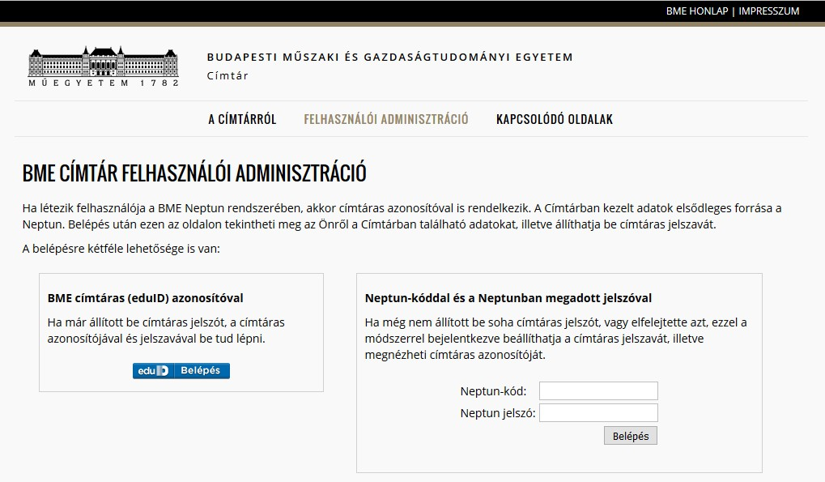
Budapest University of Technology and Economics
Department of Sanitary and Environmental Engineering
Course management and learning materials
In order to set up a BME Address Book ID or to request a new password, first you must authenticate yourself on this page with your Neptun Login
Your Neptun code
Your Neptun password

Slide 6
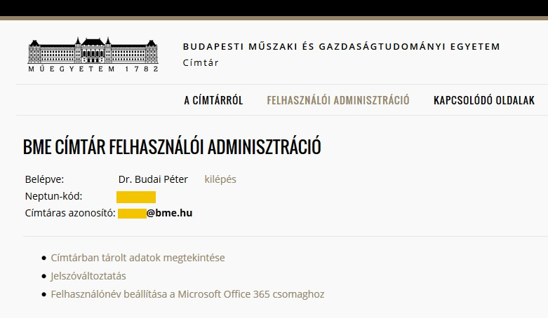
Budapest University of Technology and Economics
Department of Sanitary and Environmental Engineering
Course management and learning materials
Your BME Address Book User ID (a five-digit number before the @bme.hu) is shown here
By clicking on this link, you can set up a new password for your BME Address Book ID

Slide 7
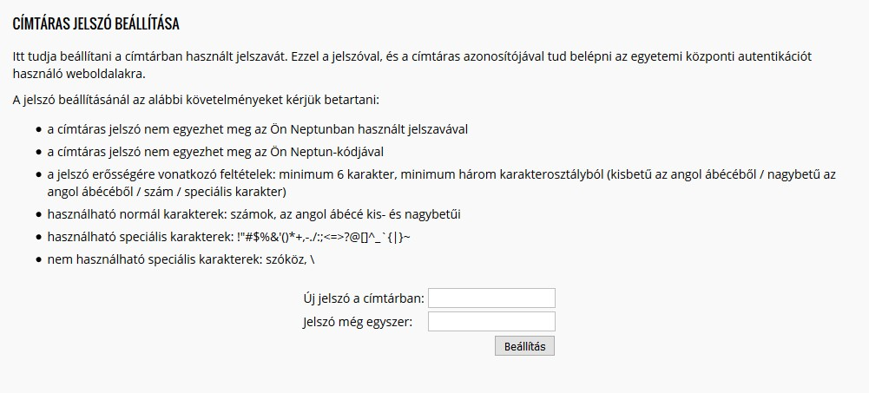
Budapest University of Technology and Economics
Department of Sanitary and Environmental Engineering
Course management and learning materials
Setting up a new password for your BME Address Book User ID
Please make sure that your new password:
does not match your Neptun password or Neptun code
consist of at least 6 characters
contains at least one character from at least three of the following classes:
capital letter (English alphabet)
lowercase letter (English alphabet)
numbers
special characters: !"#$%&'()*+,-./:;<=>?@[]^_`{|}~
does NOT contain space or the \ chaarcter
Enter new password here
Repeat the new password

Slide 8
Budapest University of Technology and Economics
Department of Sanitary and Environmental Engineering
Course management and learning materials
http://oktatas.epito.bme.hu/course/view.php?id=459&lang=en
BME Address Book – Login page
User ID: five-digit number
Password: your password

Slide 9
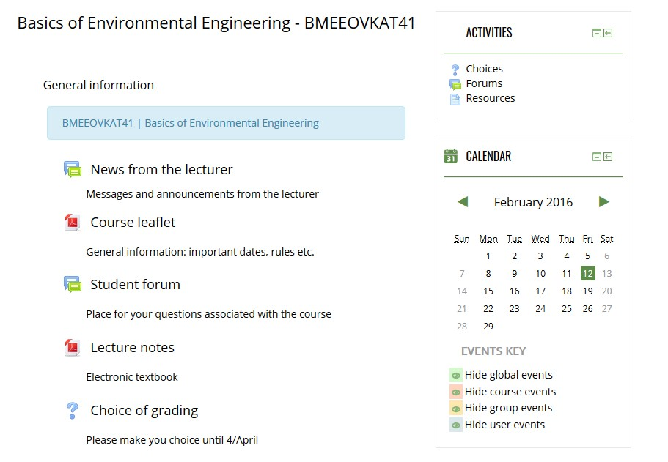
Budapest University of Technology and Economics
Department of Sanitary and Environmental Engineering
Course management and learning materials
After a successful login, you will see this page
You will find here all information (lecture notes, lecture slides etc.) about the course, as well as associated activities (message board of the lecturer, student forum, polls etc.)

